Slide 1

Enhancing Rural Energy Access: A Data-Driven Approach
Addressing Sustainable Development Goals through Data Analysis
NAME DENIS MUTHONI
DATE :09/08/2024

Slide 2
Project Overview and SDG Alignment
Project Overview:
Objective: To analyze and improve rural energy access using a comprehensive database and data analysis techniques.
SDG Alignment:
SDG 7: Affordable and Clean Energy
Focus on increasing energy access in underserved rural areas.
SDG 9: Industry, Innovation, and Infrastructure
Improve infrastructure for renewable energy.

Slide 3
Problem Definition and Significance
Problem Definition:
Many rural areas lack reliable access to energy, affecting quality of life and economic development.
Significance:
Impact on education, healthcare, and economic activities.
Importance of addressing energy access for sustainable development.

Slide 4
Database Design
Entity-Relationship Diagram (ERD):
Visual representation of entities: Region, Household, School, Business, PowerOutage, Infrastructure, RenewableEnergy, EnergyConsumption.
Relationships: One-to-Many between Region and other entities; One-to-Many between entities and Energy Consumption.
Key Entities and Relationships:
Region: Central entity, connects to all other entities.

Slide 5
Database Schema
Schema Overview:
Tables Created:
Region
Household
School
Business
PowerOutage
Infrastructure
RenewableEnergy
EnergyConsumption
Key SQL Statements:
Creation and structure of tables, including primary and foreign keys.

Slide 6
Sample Data
Sample Data Tables:
Region: Example data entries.
Household, School, Business: Sample records showing various attributes.
PowerOutage, Infrastructure, RenewableEnergy: Sample entries illustrating different types of data.
EnergyConsumption: Sample energy consumption records.

Slide 7
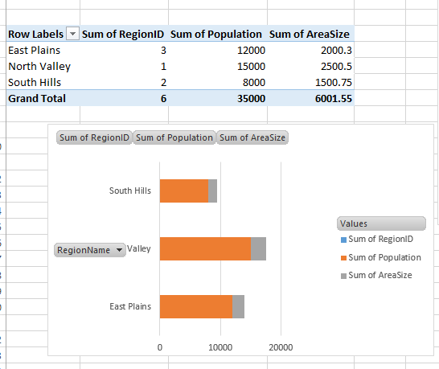
Data Analysis Insights
Total Energy Consumption by Region:
Insights on energy usage across different regions.
Average Household Size by Region:
Understanding household demographics.
Power Outages Analysis:
Frequency and impact of power outages.
Renewable Energy Capacity:
Analysis of renewable energy sources by type and capacity.
Top Region with Highest Total Energy Consumption:
Identifying the region with the greatest energy needs.

Slide 8
Excel Dashboard Overview
Dashboard Components:
PivotTables and Charts:
Total Energy Consumption by Region.
Average Household Size.
Power Outages by Region.
Renewable Energy Capacity by Type.
Interactive Elements:
Slicers: For filtering data by RegionID and EntityType.
Timeline: For date-based analysis of energy consumption.

Slide 9
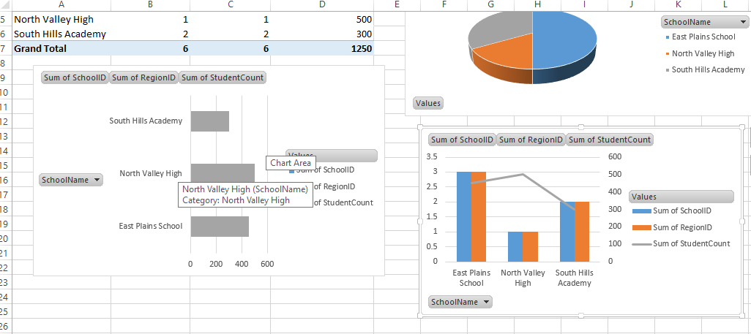
Excel Dashboard Demonstration
Charts and Graphs:
Total Energy Consumption by Region: A bar or pie chart visualizing total energy consumption across different regions.
Average Household Size by Region: A bar chart or line graph showing the average household size per region.
Renewable Energy Capacity by Type: A pie chart or bar chart detailing the distribution of renewable energy types and their capacities.
Power Outages by Region: A bar chart displaying the number of power outages experienced in each region.
Infrastructure Status: A pie chart or bar chart showing the distribution of infrastructure types and their statuses (Operational, Under Repair, etc.).

Slide 10
Conclusion and Next Steps
The project focuses on improving rural energy access by developing a detailed database and analytical tools to monitor and enhance energy infrastructure, consumption, and renewable energy use. Key components include:
Data Collection: Captures information on regions, households, schools, businesses, power outages, infrastructure, renewable energy, and energy consumption.
Data Analysis: Identifies trends, infrastructure needs, energy gaps, and opportunities for renewable energy expansion.
SDG Alignment:
SDG 7: Affordable and Clean Energy
Objective: Improve energy access and reliability.
Alignment: Enhances energy infrastructure, promotes renewable energy, and addresses energy access issues.
SDG 9: Industry, Innovation, and Infrastructure
Objective: Build resilient infrastructure and foster innovation.
Alignment: Assesses and improves energy infrastructure, supports innovative solutions.
SDG 11: Sustainable Cities and Communities
Objective: Make communities inclusive and sustainable.
Alignment: Improves living conditions in rural areas through better energy access and infrastructure.
SDG 13: Climate Action
Objective: Combat climate change and its impacts.
Alignment: Promotes renewable energy and improves energy efficiency.

